Slide 1
Chapter 5
Internetworking

Slide 2
Chapter 5.1
Routing Algorithms

Slide 3
Routing in packet switching
The main function of the network layer is routing packets from source machine to destination machine.
The routing algorithm is that part of the network layer software responsible for deciding which output line an incoming packets should be transmitted on i.e. what should be the next intermediate node for the packet .
The process of determining, selecting the best outgoing path that a packet has to take in a Internetwork.
Routing protocols use metrics to evaluate what path will be the best for a packet to travel.
Metrics: no of hops, bandwidth, delay, load, communication cost

Slide 4
Routing in Packet Switched Network
Complex, crucial aspect of packet switched networks
Characteristics required
Correctness
Simplicity
Robustness
Stability
Fairness
Optimality
Efficiency

Slide 5
Performance Criteria
Used for selection of route
Minimum hop
Least cost

Slide 6
Properties of routing algorithm
1.Correctness: The routing should be done properly and correctly so that the packets may reach their proper destination.
2.Simplicity: The routing should be done in a simple manner so that the overhead is as low as possible.
3.Robustness: Once a major network becomes operative, it may be expected to run continuously for years without any failures. The routing algorithm should be robust enough to handle software and hardware failures and should be able to cope with changes in the topology.

Slide 7
Properties of routing algorithm
4.Stability: The routing algorithm should be stable under all possible circumstances.
5.Fairness: Every node connected to the network should get a fair chance of transmitting their packets.
6.Optimality: The routing algorithm should be optimal in terms of throughput and minimizing mean packet delays.

Slide 8
Routing Metrics
Path Length
Reliability
Delay
Bandwidth
Load
Communication cost

Slide 9
Classification of routing algorithms
The routing algorithms may be classified as follows.
Adaptive algorithm
Non-adaptive algorithm

Slide 10
Adaptive routing algorithms
Adaptive routing algorithms change their routing decisions to reflect changes in the topology and in traffic as well.
These get their routing information from adjacent routers or from all routers.
Routing decisions may be changed when network topology and/or traffic load changes.
Also known as dynamic routing algorithm

Slide 11
Type of adaptive
Adaptive routing algorithms can be further divided into three
Isolated: Each router makes its routing decisions using only the local information it has on hand. Specially, routers don’t even exchange information with neighbors
Centralized: A centralized node makes all routing decisions. Specially, the centralized node has access to global information
Distributed: Algorithms that use a combination of local and global information.

Slide 12
Non-adaptive routing algorithms
These algorithms don’t change their routing decisions on measurements and estimates of the current traffic and topology.
Instead the route to be taken is going from one node to the other is computed in advance, off-line and downloaded to the routers when the network is booted.
This is also known as static routing.
This can be further classified as:
Fixed
Flooding
Random walk

Slide 13
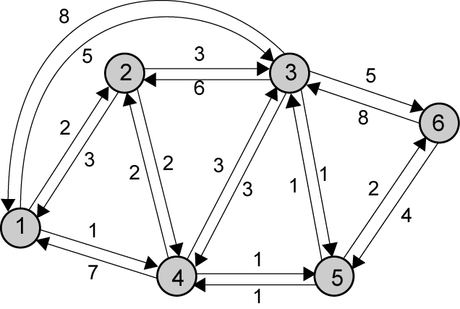
Example Packet Switched Network

Slide 14
Routing Strategies
Fixed
Flooding
Random

Slide 15
Fixed Routing
Single permanent route for each source to destination pair
Determine routes using a least cost algorithm
Route fixed, at least until a change in network topology

Slide 16
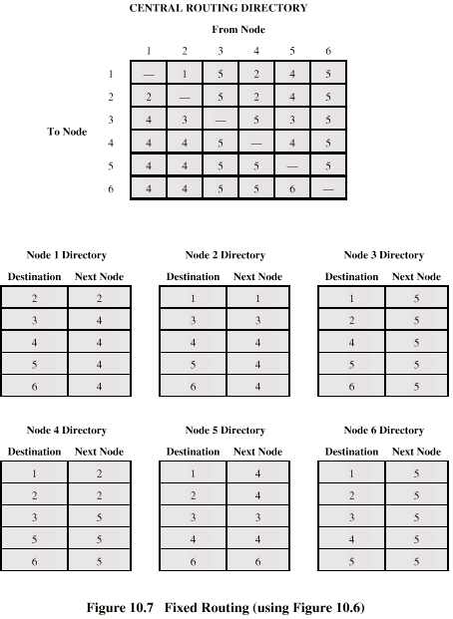
Fixed RoutingTables

Slide 17
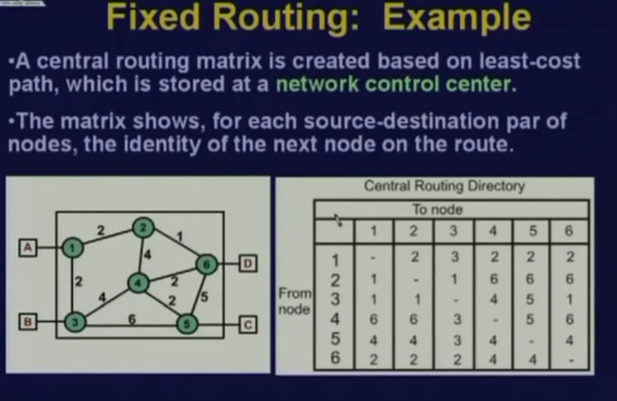

Slide 18
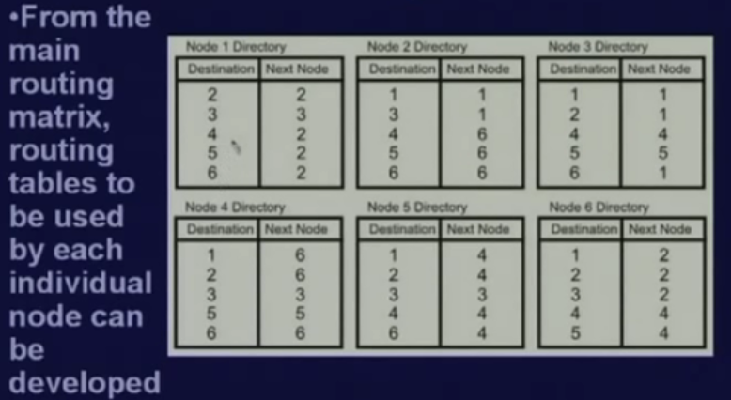

Slide 19
Flooding
No network info required
Packet sent by node to every neighbor
Incoming packets retransmitted on every link except incoming link
Eventually a number of copies will arrive at destination
Each packet is uniquely numbered so duplicates can be discarded
Nodes can remember packets already forwarded to keep network load in bounds
Can include a hop count in packets

Slide 20
Flooding……….
Flooding adapts the technique in which every incoming packet is sent on every outgoing line except the one on which it arrived.
One problem with this method is that packets may go in a loop.
As a result of this a node may receive several copies of a particular packet which is undesirable
Flood:-router forward packets to all ports expect the ingress port.

Slide 21
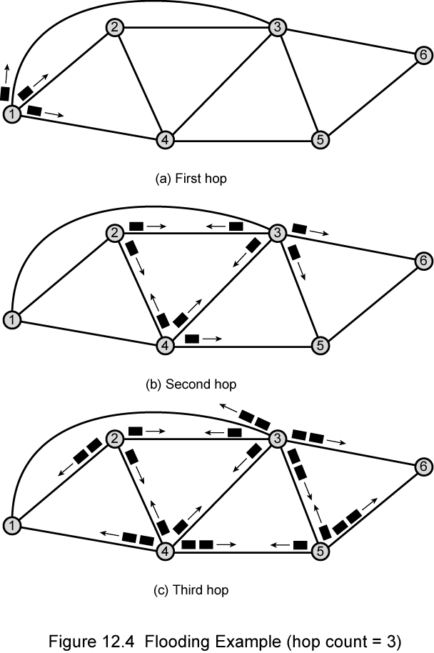
Flooding Example

Slide 22
Properties of Flooding
All possible routes are tried
Very robust
At least one packet will have taken minimum hop count route
Can be used to set up virtual circuit
All nodes are visited
Useful to distribute information (e.g. routing)

Slide 23
Advantages& Disadvantages of Flooding
Advantages:
Simple.
Every destination in the network is reachable.
Disadvantages:
Some routers receive a packet multiple times.
Packets can go round in loops as long as TTL>0.
Inefficient.

Slide 24
Random Routing
Node selects one outgoing path for retransmission of incoming packet
Selection can be random or round robin
Can select outgoing path based on probability calculation
No network info needed
Route is typically not least cost nor minimum hop

Slide 25
Random Routing
In this method, a packet is sent by the node to one of its neighbors randomly.
This algorithm is highly robust.
When the network is highly interconnected, this algorithm has the property of making excellent use of alternative route.

Slide 26
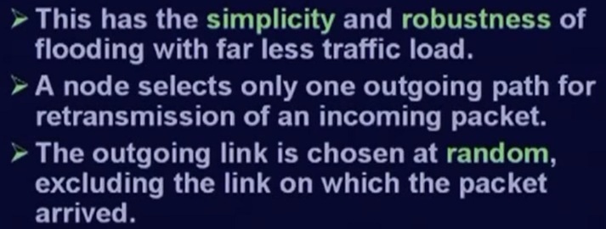
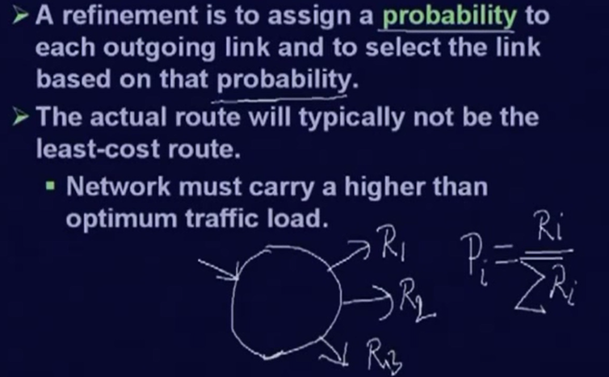

Slide 27
Adaptive Routing
Used by almost all packet switching networks
Routing decisions change as conditions on the network change
Failure
Congestion
Requires info about network
Decisions more complex
Tradeoff between quality of network info and overhead
Reacting too quickly can cause oscillation
Too slowly to be relevant

Slide 28
Routing Protocols
Intradomain
Distance vector
Link State
Interdomain
Path Vector

Slide 29
Distance Vector Routing
Assume:
Each router knows only address/cost of neighbors
Goal:
Calculate routing table of next hop information for each destination at each router
Idea:
Tell neighbors about learned distances to all destinations

Slide 30
Distance vector routing
Every router maintains its distance vector (DV) which records distance to each of other hosts.
Every router exchanges DV with its neighbors periodically.
Whenever a router receives a DV from its neighbor, it checks whether new better routes through this neighbor can be found, if yes, modifies its DV.
From its DV, a router can directly derive its routing table.
Distance vector routing uses Bellman-Ford algorithm

Slide 31
Distance vector routing....
Each router maintains a vector of costs to all destinations as well as routing table
Initialize neighbors with known cost, others with infinity
Periodically send copy of distance vector to neighbors
On reception of a vector, if neighbors path to a destination plus neighbor cost is better, then switch to better path
update cost in vector and next hop in routing table

Slide 32
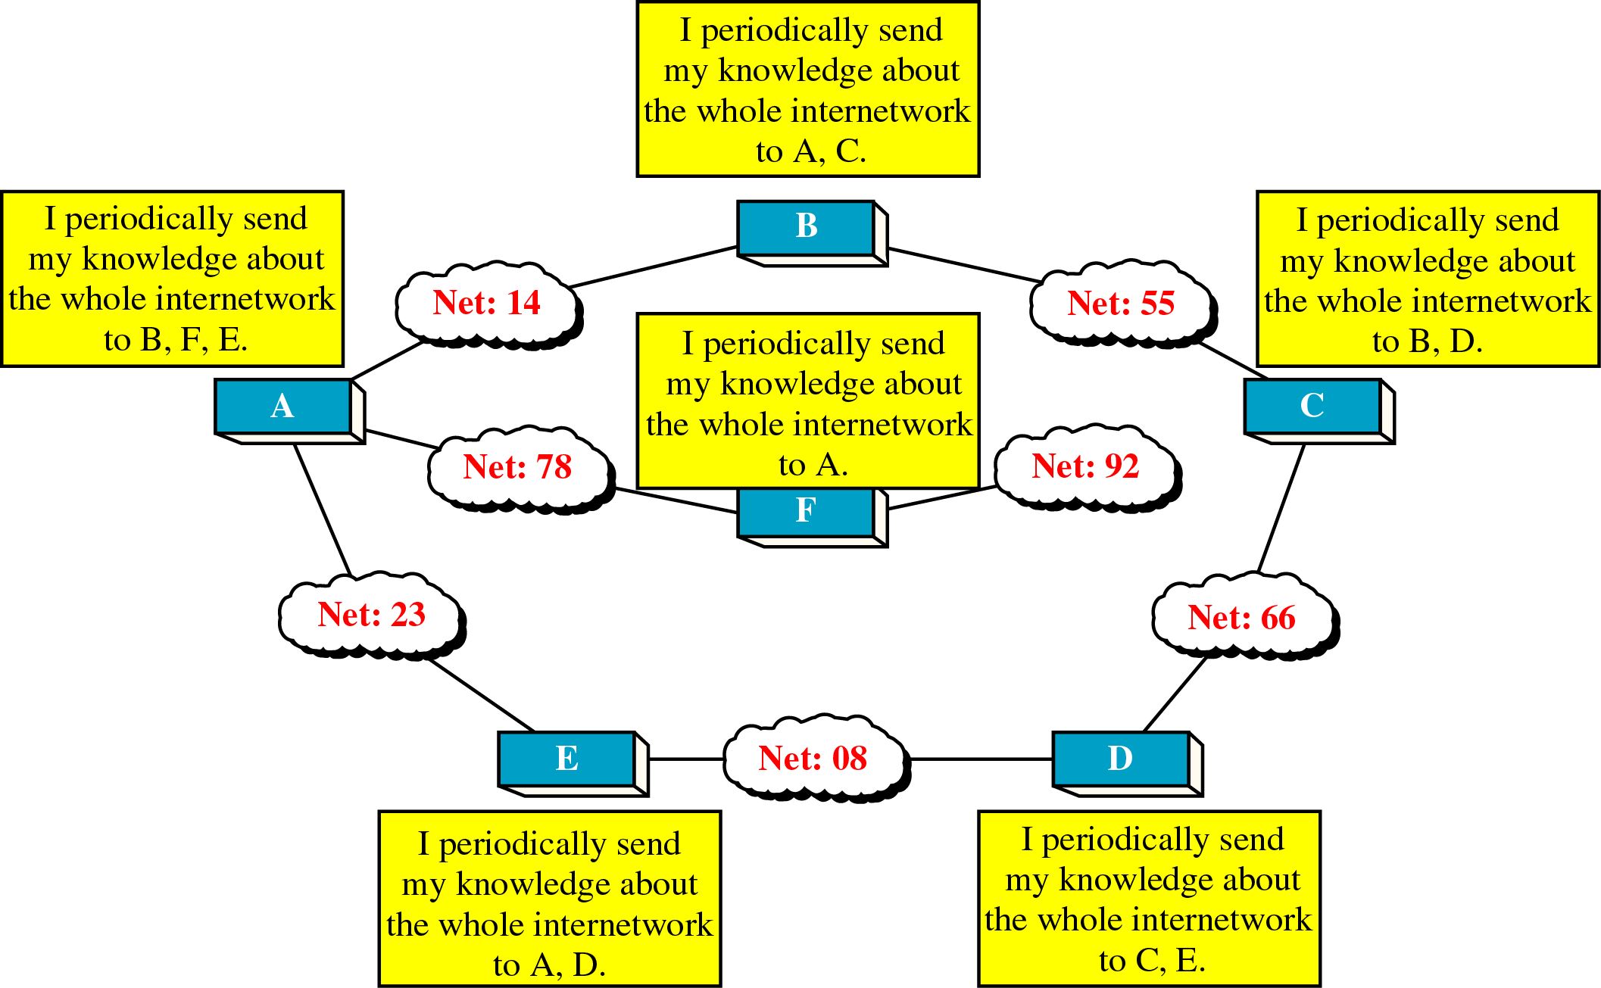
The Concept of Distance Vector Routing

Slide 33
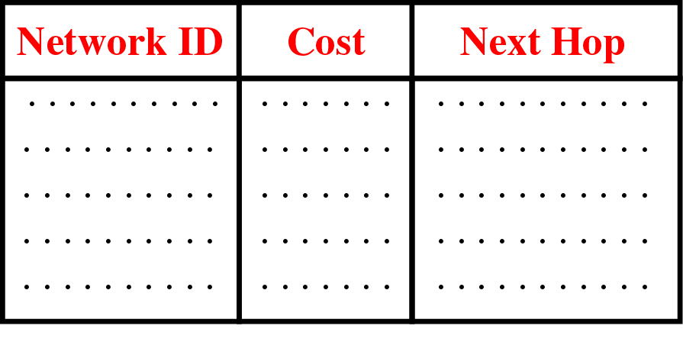
Distance Vector Routing Table

Slide 34
Distance…….
Periodic updates
Slow convergence
Routing table from directly connected neighbor routers
Add distances before passing it to other
neighbors
Distance is defined in terms of a metric,
such as hop count (RIP), composite of BW and delay(IGRP)

Slide 35
When Routing updates
1.Periodic Update:
A node sends its routing table, normally every 30 s, in a periodic update. The period depends on the protocol that is using distance vector routing.
2.Triggered Update:
A node sends its two-column routing table to its neighbors anytime there is a change in its routing table. This is called a triggered update.
The change can result from the following.
1. A node receives a table from a neighbor, resulting in changes in its own table after updating.
2. A node detects some failure in the neighboring links which results in a distance change to infinity

Slide 36
Bellman-Ford algorithm
Principle: if node N is in the shortest path from A to B, then the path from A to N is also the shortest path and the path from N to B is also the shortest path.
Formalization:
consider node i to a destination d.
define D_{j} to be the current estimate of minimum cost from node j to destination d. of course D_{d}=0.
let C_{ij} be the link cost from node i to node j . C_{ii}=0 and C_{ij}=∞ if i and j are not directly connected.
D_{i}=min{C_{ij}+D_{j}}, ∀ j ≠ i = min{C_{ik}+D_{k}}, k is i’s neighbor.
Algorithm (computing shortest path from nodes to destination d):
Initialization: D_{i} = ∞, ∀i ≠ d, and D_{d}=0
Updating: for each i ≠ d, D_{i}=min{C_{ik}+D_{k}}, k is i’s neighbor
Repeat step 2 until no more changes occur in the iteration.

Slide 37
Shortest path principle
2
1
1
3
5
6
2
3
1
4
2
3
2
4
5
Want to compute shortest path from 2 → 6,
If was told that 1→6 is 3, then 2→6 via 1 is 3+3=6
4→6 is 3, 2→6 via 4 is 1+3=4
5→6 is 2 2→6 via 5 is 4+2=6
therefore shortest path from 2→6 is achieved if first go to 4.
Figure 7.28

Slide 38
Back
Shortest path formalization
2
1
1
3
5
6
2
3
1
4
2
3
2
4
5
Want to compute shortest path from 2 → 6,
Suppose D₁ = 3, and C₂₁ = 3
D₄ = 3, C₂₄ = 1
D₅ = 2 C₂₅ = 4
therefore shortest path from 2→6 is computed as
D₂ =min{C₂₁+D₁, C₂₄+D₄, C₂₅+D₅}
= min{3+3, 1+3, 4+2} = 4

Slide 39
Shortest path computation to node 6
For each node i, label it as (n,D_{i}) where D_{i} is the current
minimum cost from i to the destination and n is the next
node along the current shortest path.
2
1
1
3
5
6
2
3
1
4
2
3
2
4
5
Iteration Node 1 Node 2 Node 3 Node 4 Node 5
Initial (-1,∞) (-1,∞) (-1,∞) (-1,∞) (-1,∞)
1 (-1,∞) (-1,∞) (6,1) (-1, ∞) (6,2)
2 (3,3) (5,6) (6,1) (3,3) (6,2)
3 (3,3) (4,4) (6,1) (3,3) (6,2)
4 (3,3) (4,4) (6,1) (3,3) (6,2)

Slide 40
Shortest path tree – from all nodes to a destination
2
1
1
3
6
2
4
1
2
2
5

Slide 41
Another view of shortest paths: from a node to all destination
suppose for node 2, shortest paths to all other destinations
The red lines indicate shortest paths from node 2 to all other nodes.
2
1
1
3
5
6
2
3
1
4
2
3
2
4
5
The distance vector in node 2:
Destination distance next node
1 3 1
3 3 4
4 1 4
5 4 5
6 4 4
The routing table in node 2:
Destination next node
1 1
3 4
4 4
5 5
6 4

Slide 42
How node 2 computes shortest paths to all other destinations
After receiving distance vector from 4, node 2 modifies its initial distance vector
2
1
1
3
5
6
2
3
1
4
2
3
2
4
5
Initial distance vector in node 2
Destination distance next node
1 3 1
3 ∞ -1
4 1 4
5 4 5
6 ∞ -1
New distance vector in node 2
Destination distance next node
1 3 1
3 3 4
4 1 4
5 4 5
6 ∞ -1
Receive distance vector from node 4
Destination distance
1 5
2 1
3 2
5 3
6 ∞

Slide 43
How node 2 computes shortest to all other destination
When receiving distance vector from 5, modify its distance vector
2
1
1
3
5
6
2
3
1
4
2
3
2
4
5
Current distance vector in node 2
Destination distance next node
1 3 1
3 3 4
4 1 4
5 4 5
6 ∞ -1
Receive distance vector from node 5
destination distance
1 ∞
2 4
3 ∞
4 3
6 2
New distance vector in node 2
Destination distance next node
1 3 1
3 3 4
4 1 4
5 4 5
6 6 5

Slide 44
How node 2 computes shortest to all other destination
When receiving distance vector from 4, modify its distance vector again
At this time, the distance vector converges to stable state
2
1
1
3
5
6
2
3
1
4
2
3
2
4
5
New distance vector in node 2
Destination distance next node
1 3 1
3 3 4
4 1 4
5 4 5
6 4 4
Current distance vector in node 2
Destination distance next node
1 3 1
3 3 4
4 1 4
5 4 5
6 6 5
Receive distance vector from node 4
Destination distance
1 5
2 1
3 2
5 3
6 3

Slide 45
What if there are changes?
One scenario: Suppose link between F and G fails
F notices failure, sets its cost to G to infinity and tells A
A sets its cost to G to infinity too, since it learned it from F
A learns route from C with cost 2 and adopts it
Dest | Cost | Next
B | 1 | B
C | 1 | C
D | 2 | C
E | 1 | E
F | 1 | F
G | 3 | C
XXXXX

Slide 46
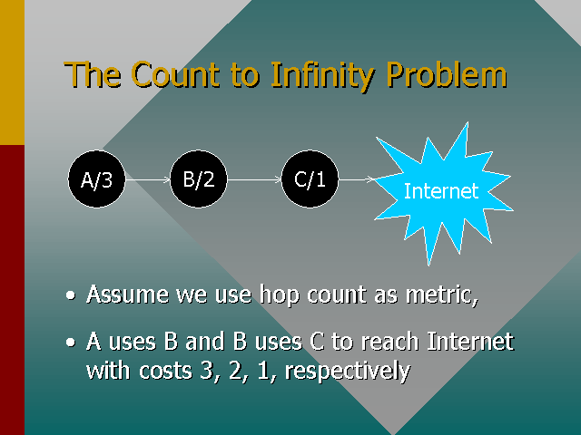
Count To infinity Problem

Slide 47
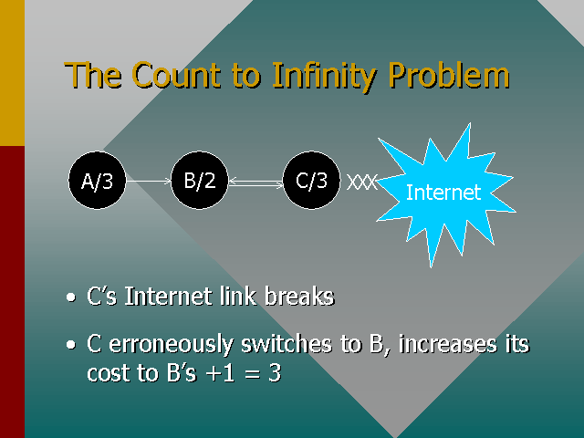

Slide 48
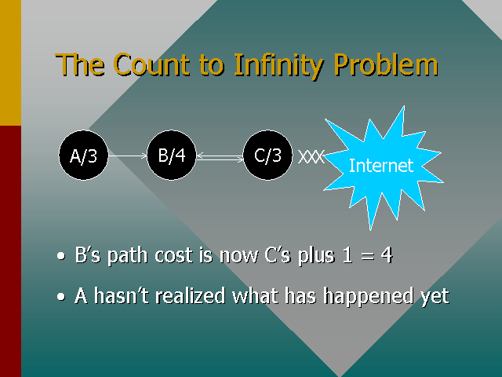

Slide 49
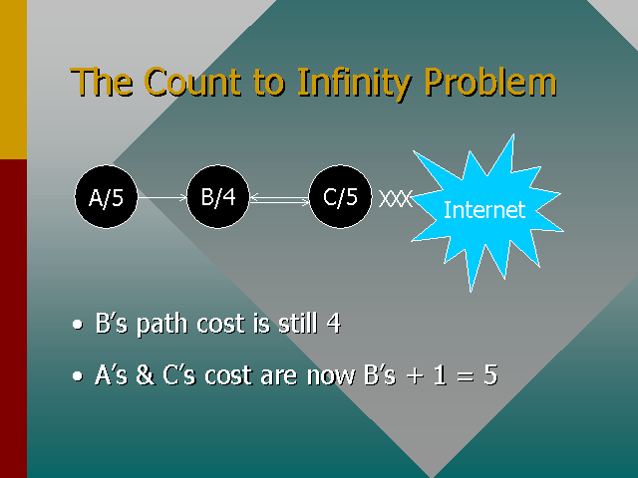

Slide 50
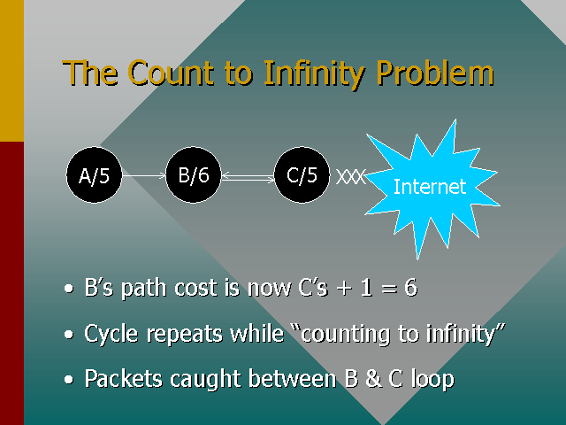

Slide 51
Count To Infinity Problem
Simple example
Costs in nodes are to reach Internet
Now link between B and Internet fails …
Internet
A/2
B/1

Slide 52
Count To Infinity Problem
B hears of a route to the Internet via A with cost 2
So B switches to the “better” (but wrong!) route
Internet
A/2
B/3
XXX
update

Slide 53
Count To Infinity Problem
A hears from B and increases its cost
Internet
A/4
B/3
XXX
update

Slide 54
Count To Infinity Problem
B hears from A and (surprise) increases its cost
Cycle continues and we “count to infinity”
Packets caught in the crossfire loop between A and B
Internet
A/4
B/5
XXX
update

Slide 55
Solution to count to infinity
Split Horizon
Never advertise the cost to a neighbor if this neighbor is the next hop on the current path. With split horizon, when a node sends a routing table update to its neighbors, it does not send those routes it learned from a particular neighbor, back to that neighbor

Slide 56
Split Horizon and Poison Reverse
Using the split horizon strategy has one drawback.
Normally, the distance vector protocol uses a timer, and if there is no news about a route, the node deletes the route from its table.
When node B in the previous scenario eliminates the route to X from its advertisement to A, node A cannot guess that this is due to the split horizon strategy (the source of information was A) or because B has not received any news about X recently.
The split horizon strategy can be combined with the poison reverse strategy.
Node B can still advertise the value for X, but if the source of information is A, it can replace the distance with infinity as a warning: "Do not use this value; what I know about this route comes from you."

Slide 57
The Split Horizon Hack
Actual distance to a destination is not reported on the line on which packets to that destination are sent.
Instead these distances are reported as “infinity.”
A
B
C
C tells D the truth
about its distance to
A, but lies to B and
says the distance is
infinity.
D

Slide 58
Link state routing
In link state routing, if each node in the domain has the entire topology of the domain the list of nodes and links, how they are connected including the type, cost (metric), and condition of the links (up or down)-
Every router maintains its link state packet (LSP) which records the state information of links to all its neighbors.
A router floods its LSP to entire network, i.e., all routers, (whenever its link state changes)
When a router receives LSPs from other routers, it can construct a map of entire network and from the map, compute shortest paths between any pair of host (using Dijkstra algorithm), thus, derive its routing table.

Slide 59
Link-State Routing Process
1. Each router learns about its own links (directly connected networks)
2. Find directly connected neighbors
3. Builds a Link-State Packet (LSP) with the state of each directly connected link
4. Floods the LSP to all neighbors, who stores the received LSPs in a database
5. Each router uses the database to construct a complete map of the network topology
6. Computes the best path to each destination network

Slide 60
Link State……
Complex database of topology information
• Knowledge of the entire network
• Uses SPF to calculate the best path
• Updates when changes in the topology occurs
• Fast Convergence
• More memory and processor overhead

Slide 61
1.) Discovering Your Neighbors
Send “Hello” packet on each point-to-point line. Destination node replies with its address.

Slide 62
2.) Measuring Line Cost
Send an “ECHO” packet over the line.
Destination is required to respond to “ECHO” packet immediately.
Measure the time required for this operation.
Question: Should we measure just the time it takes to transmit the packet, or should we include the time that the packet waits in the queue?

Slide 63
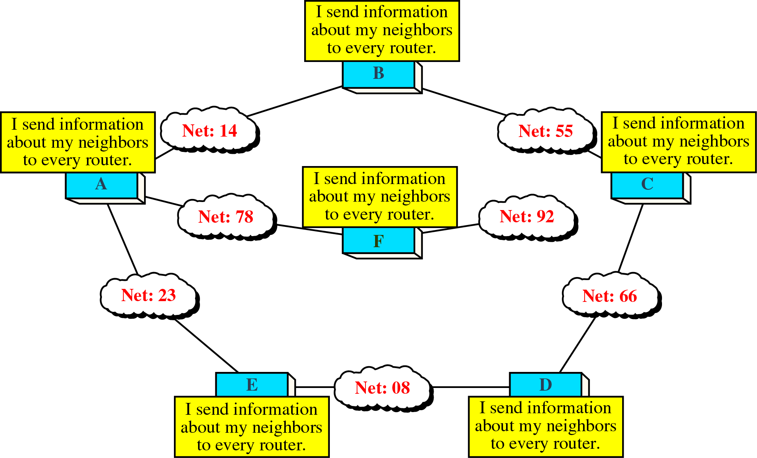
Concept of Link State Routing

Slide 64
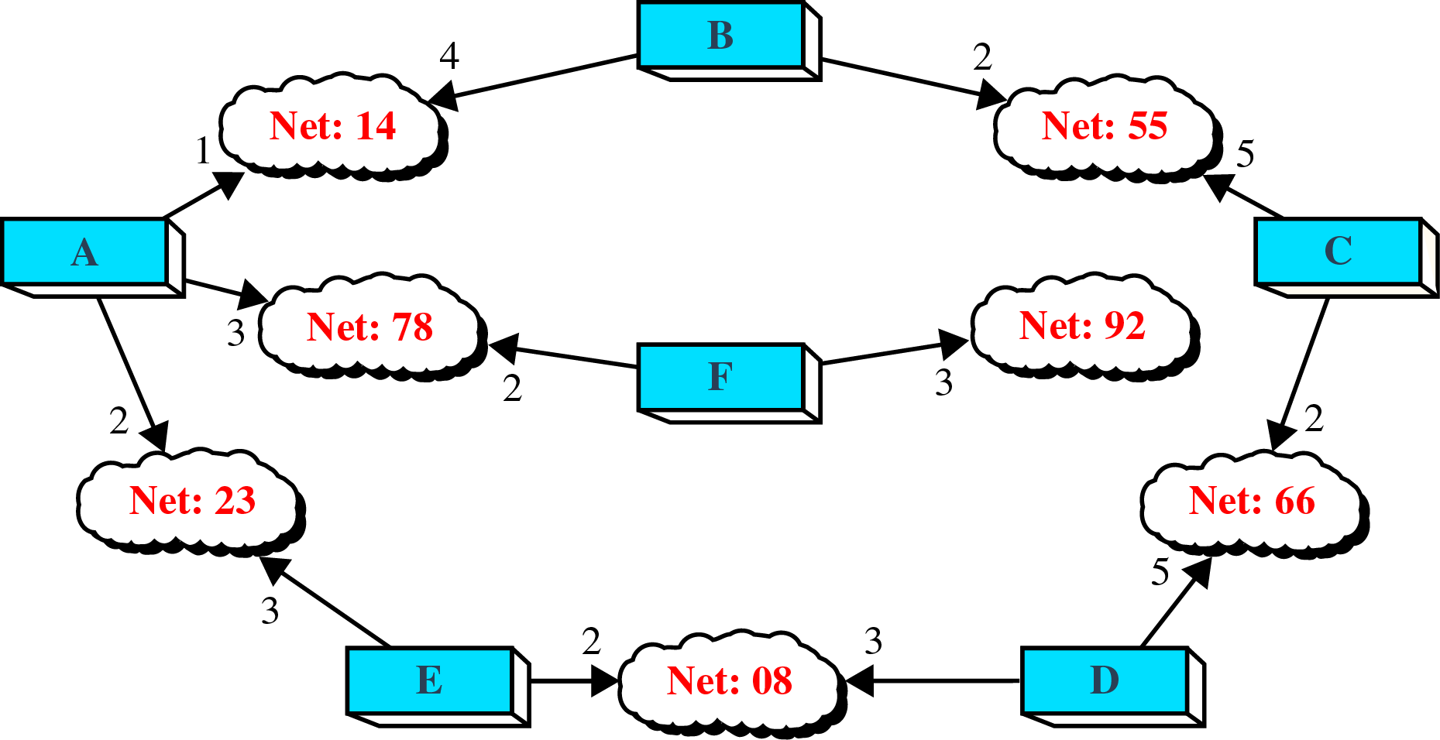
Cost in Link State Routing

Slide 65
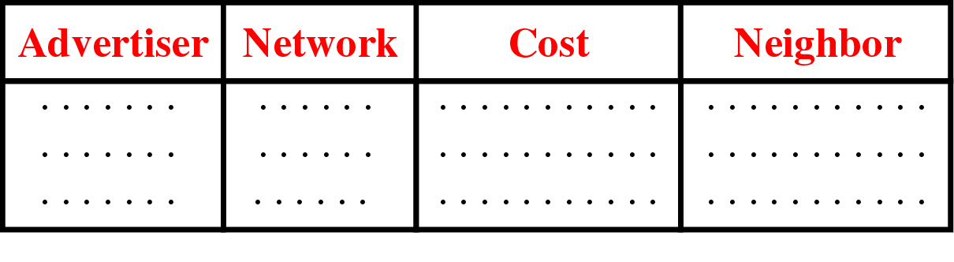
Link State Packet

Slide 66
Advantages with Link-State Protocols
• Builds a topological map
– Full knowledge of the network
• Fast convergence
– Floods LSPs immediately
• Event-driven updates
– LSP sent when there is a change, only contains
information regarding the affected link
• Hierarchical design
– Areas can be used to separate routing traffic

Slide 67
Disadvantages with Link-State Protocol
• Significant demands on memory and processing resources
• Requires very strict network design
• Requires a knowledgeable network administrator
• Initial flooding can impede network performance

Slide 68
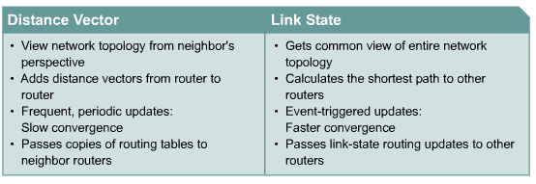
DV vs LS

Slide 69
Attributes | Distance vector | Link State
Algorithm | Bellman-Ford | Dijsktra
Network view | Topology knowledge from the neighbour point of view | Common and complete knowledge of the network topology
Best Path Calculation | Based on fewest number of hops | Based on the cost
Updates Frequency | Frequently periodic updates | Triggered updates
Routing Loops | Needs additional procedures to avoid them | By construction, routing loops cannot happen
CPU and Memory | Low utilization | Intensive
Simplicity | High simplicity | Requires a trained network administrator
Updates | On broadcast | On multi cast
HOP | Limited | Unlimited
Convergence | Slow | fast

Slide 70
Dijkstra’s algorithm & link state routing
Suppose the topology of a network (i.e., a graph) is known, Dijkstra’s algorithm will find the shortest paths from a node n to all other nodes as follows:
Find the closest node (say n1) from node n, which is a neighbor of n. modify the costs of other nodes.
Find the second closest node (say n2) from n, which is a neighbor of n or n1. Modify the costs of other nodes.
Find the third closest node (say n3)from n, which is a neighbor of n, n1, or n2. Modify the costs of other nodes.
……
How does a node get the network topology?
Every node has a link state packet (LSP) which records its neighbors and the costs to these neighbors.
Every node floods its LSP to the entire network (all nodes) at beginning or whenever link statuses change.
Any node can construct the network topology after it receives all LSPs.

Slide 71
Example: Dijkstra’s algorithm
2
1
1
3
5
6
2
3
1
4
2
3
2
4
5
Iteration N D2 D3 D4 D5 D6
Initial {1} 3 2 5 ∞ ∞
1 {1,3} 3 2 4 ∞ 3
2 {1,2,3} 3 2 4 7 3
3 {1,2,3,6} 3 2 4 5 3
4 {1,2,3,4,6} 3 2 4 5 3
5 {1,2,3,4,5,6} 3 2 4 5 3

Slide 72
Shortest path tree from node 1 to other nodes after using Dijkstra’s algorithm
2
1
3
1
6
2
3
4
2
2
5
Routing table from shortest path tree for node 1
Destination next node cost
2 2 3
3 3 2
4 3 4
5 3 5
6 3 3

Slide 73
Least Cost Algorithms
Basis for routing decisions
Can minimize hop with each link cost 1
Can have link value inversely proportional to capacity
Given network of nodes connected by bi-directional links
Each link has a cost in each direction
Define cost of path between two nodes as sum of costs of links traversed
For each pair of nodes, find a path with the least cost
Link costs in different directions may be different
E.g. length of packet queue

Slide 74
Dijkstra’s Algorithm Definitions
Find shortest paths from given source node to all other nodes, by developing paths in order of increasing path length
N = set of nodes in the network
s = source node
T = set of nodes so far incorporated by the algorithm
w(i, j) = link cost from node i to node j
w(i, i) = 0
w(i, j) = ∞ if the two nodes are not directly connected
w(i, j) ≥ 0 if the two nodes are directly connected
L(n) = cost of least-cost path from node s to node n currently known
At termination, L(n) is cost of least-cost path from s to n

Slide 75
Dijkstra’s Algorithm Method
Step 1 [Initialization]
T = {s} Set of nodes so far incorporated consists of only source node
L(n) = w(s, n) for n ≠ s
Initial path costs to neighboring nodes are simply link costs
Step 2 [Get Next Node]
Find neighboring node not in T with least-cost path from s
Incorporate node into T
Also incorporate the edge that is incident on that node and a node in T that contributes to the path
Step 3 [Update Least-Cost Paths]
L(n) = min[L(n), L(x) + w(x, n)] for all n ∉ T
If latter term is minimum, path from s to n is path from s to x concatenated with edge from x to n
Algorithm terminates when all nodes have been added to T

Slide 76
Dijkstra’s Algorithm Notes
At termination, value L(x) associated with each node x is cost (length) of least-cost path from s to x.
In addition, T defines least-cost path from s to each other node
One iteration of steps 2 and 3 adds one new node to T
Defines least cost path from s to that node

Slide 77
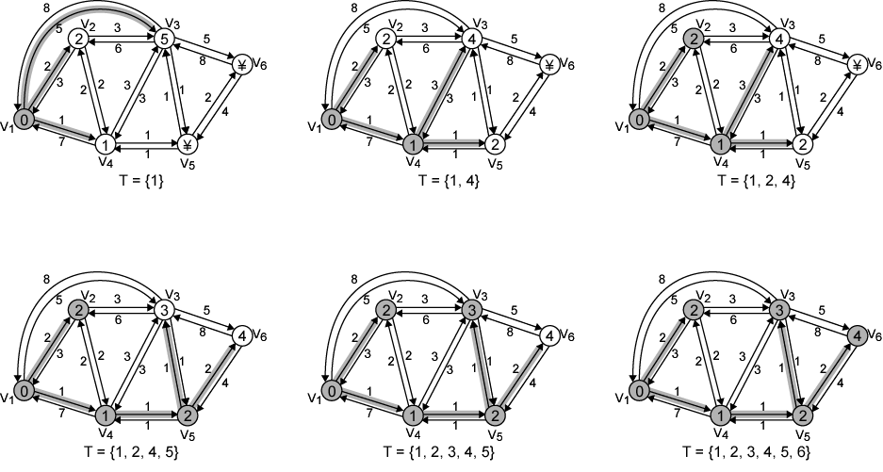
Example of Dijkstra’s Algorithm

Slide 78
Results of Example Dijkstra’s Algorithm
Iteration | T | L(2) | Path | L(3) | Path | L(4) | Path | L(5) | Path | L(6) | Path
1 | {1} | 2 | 1–2 | 5 | 1-3 | 1 | 1–4 | ∞ | - | ∞ | -
2 | {1,4} | 2 | 1–2 | 4 | 1-4-3 | 1 | 1–4 | 2 | 1-4–5 | ∞ | -
3 | {1, 2, 4} | 2 | 1–2 | 4 | 1-4-3 | 1 | 1–4 | 2 | 1-4–5 | ∞ | -
4 | {1, 2, 4, 5} | 2 | 1–2 | 3 | 1-4-5–3 | 1 | 1–4 | 2 | 1-4–5 | 4 | 1-4-5–6
5 | {1, 2, 3, 4, 5} | 2 | 1–2 | 3 | 1-4-5–3 | 1 | 1–4 | 2 | 1-4–5 | 4 | 1-4-5–6
6 | {1, 2, 3, 4, 5, 6} | 2 | 1-2 | 3 | 1-4-5-3 | 1 | 1-4 | 2 | 1-4–5 | 4 | 1-4-5-6

Slide 79
Comparison
Results from two algorithms agree
Information gathered
Bellman-Ford
Calculation for node n involves knowledge of link cost to all neighboring nodes plus total cost to each neighbor from s
Each node can maintain set of costs and paths for every other node
Can exchange information with direct neighbors
Can update costs and paths based on information from neighbors and knowledge of link costs
Dijkstra
Each node needs complete topology
Must know link costs of all links in network
Must exchange information with all other nodes

